Slide 1

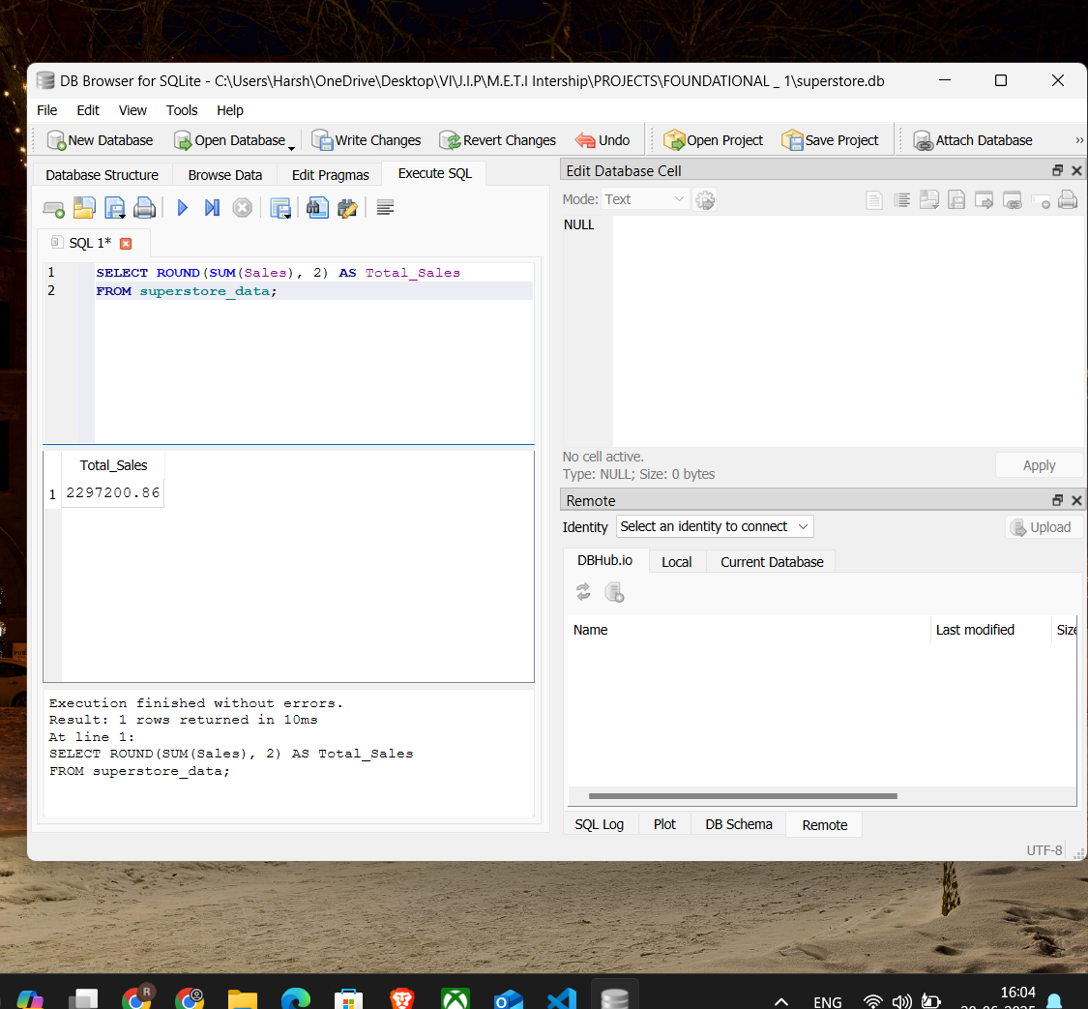
Superstore Sales Performance Analysis
1) SELECT ROUND(SUM(Sales), 2) AS Total_Sales
FROM superstore_data;

Slide 2
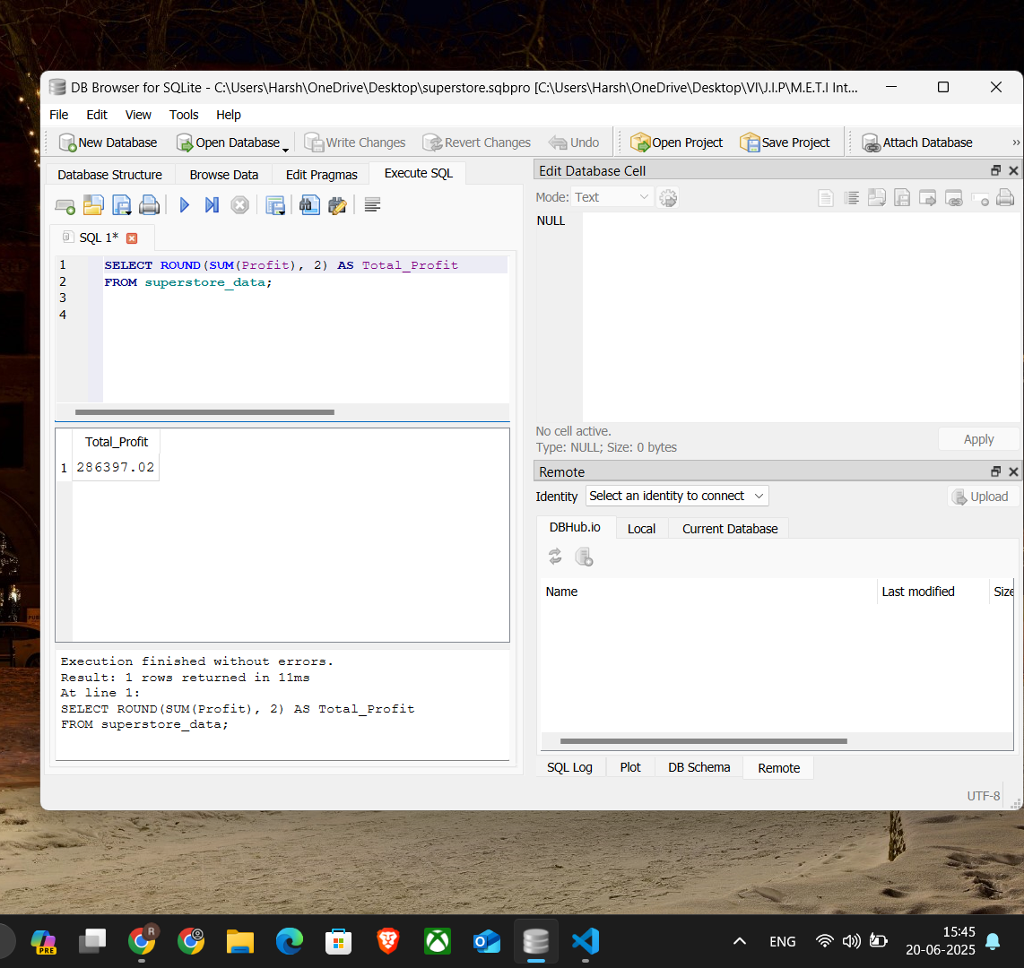
2) SELECT ROUND(SUM(Profit), 2) AS Total_Profit FROM superstore_data;
2) SELECT ROUND(SUM(Profit), 2) AS Total_Profit
FROM superstore_data;

Slide 3
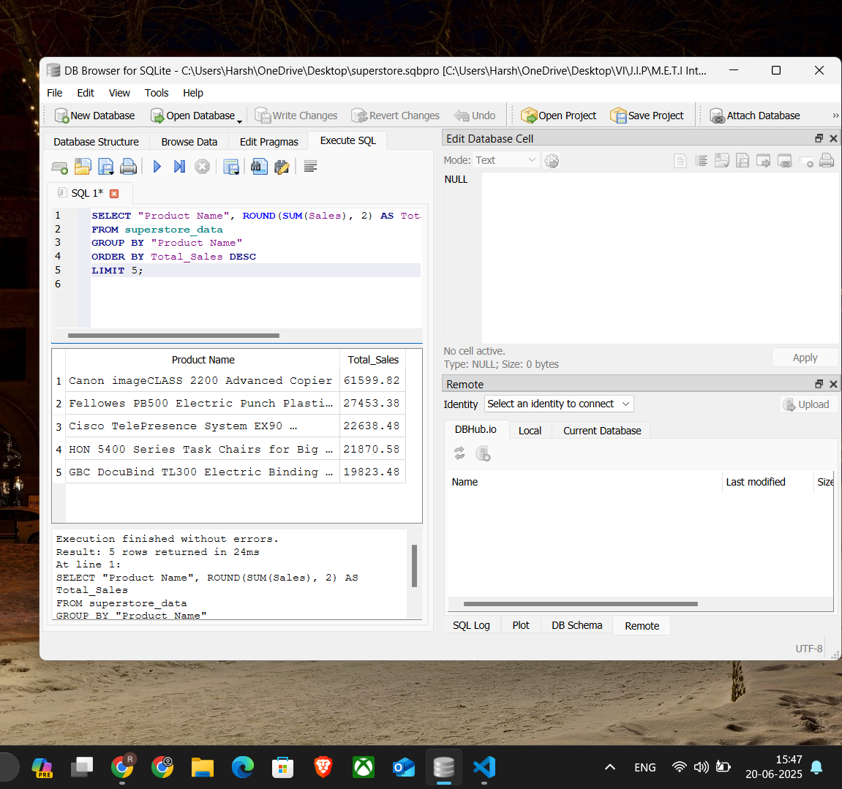
3) SELECT "Product Name", ROUND(SUM(Sales), 2) AS Total_Sales
FROM superstore_data
GROUP BY "Product Name"
ORDER BY Total_Sales DESC
LIMIT 5;

Slide 4
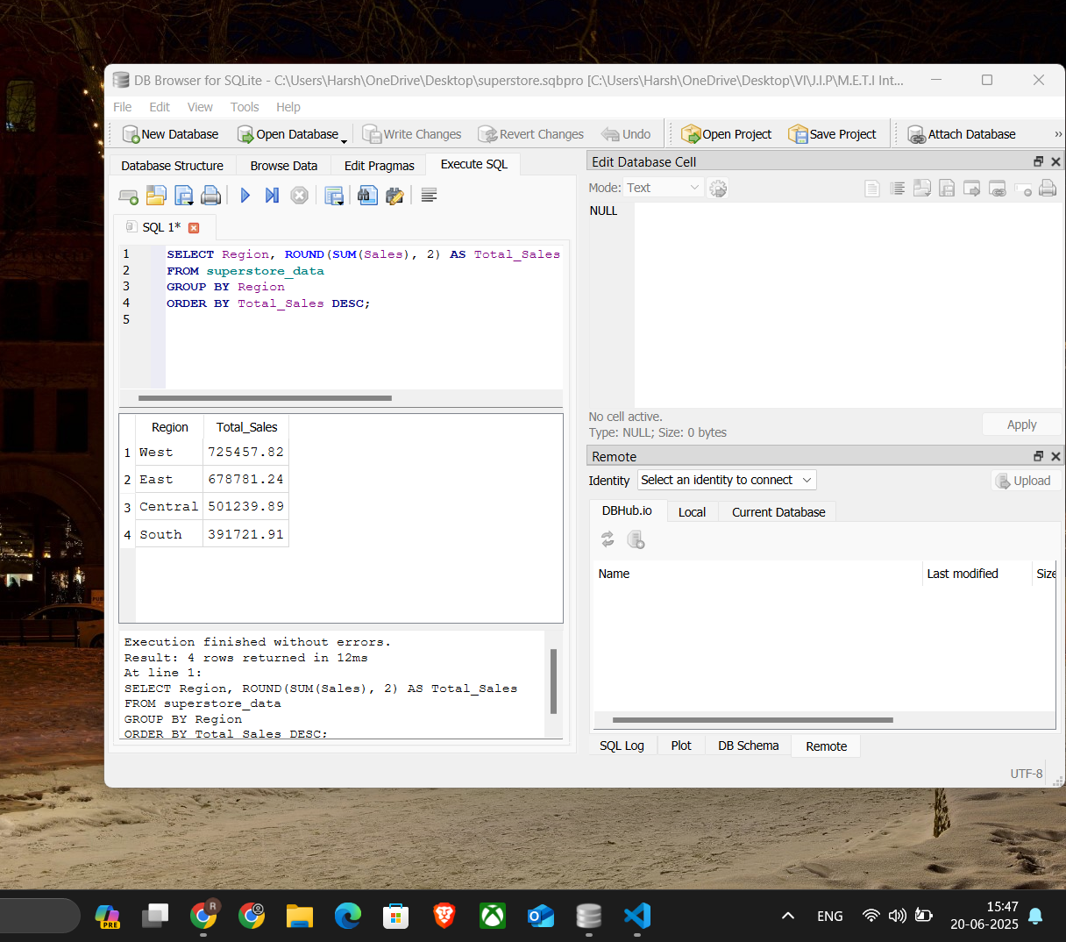
4) SELECT Region, ROUND(SUM(Sales), 2) AS Total_Sales
FROM superstore_data
GROUP BY Region
ORDER BY Total_Sales DESC;

Slide 5
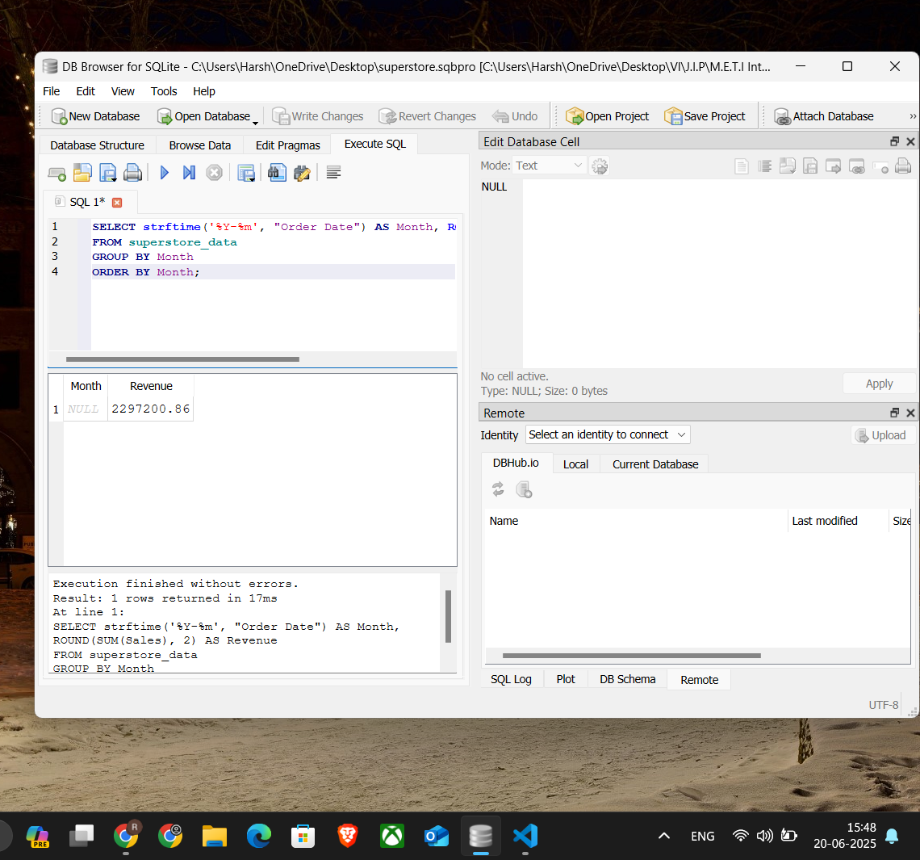
5) SELECT strftime('%Y-%m', "Order Date") AS Month, ROUND(SUM(Sales), 2) AS Revenue
FROM superstore_data
GROUP BY Month
ORDER BY Month;

Slide 6
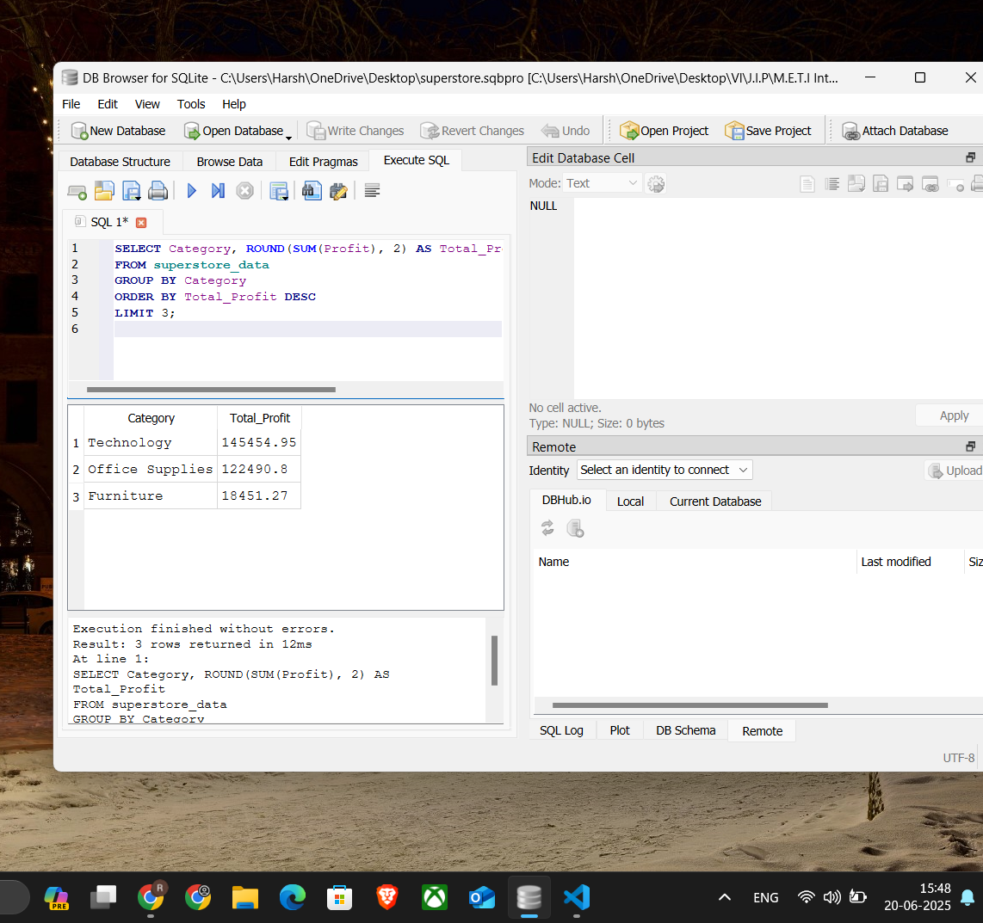
6) SELECT Category, ROUND(SUM(Profit), 2) AS Total_Profit
FROM superstore_data
GROUP BY Category
ORDER BY Total_Profit DESC
LIMIT 3;

Slide 7
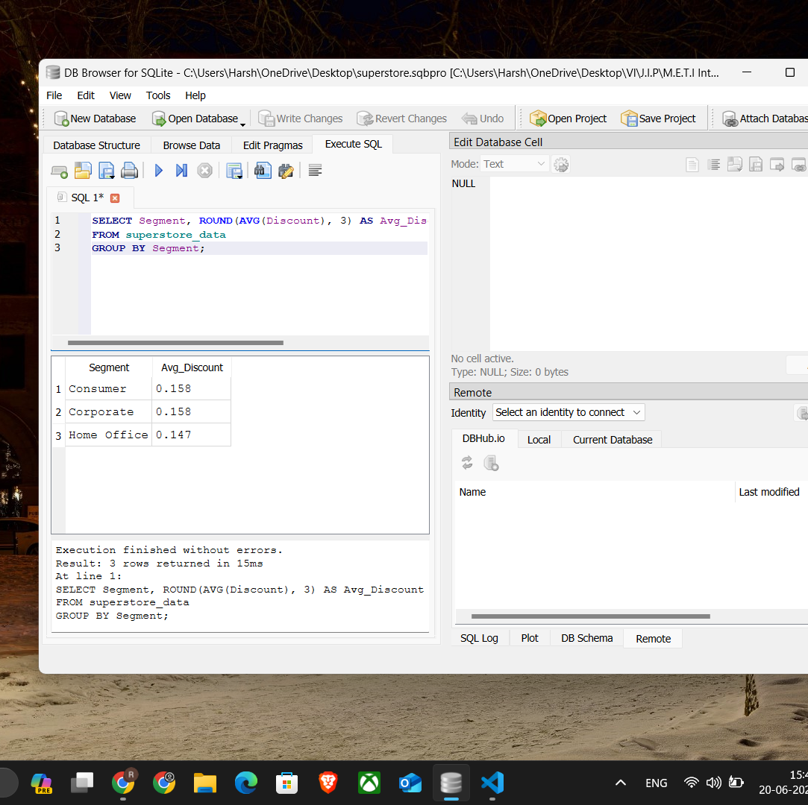
7) SELECT Segment, ROUND(AVG(Discount), 3) AS Avg_Discount
FROM superstore_data
GROUP BY Segment;

Slide 8
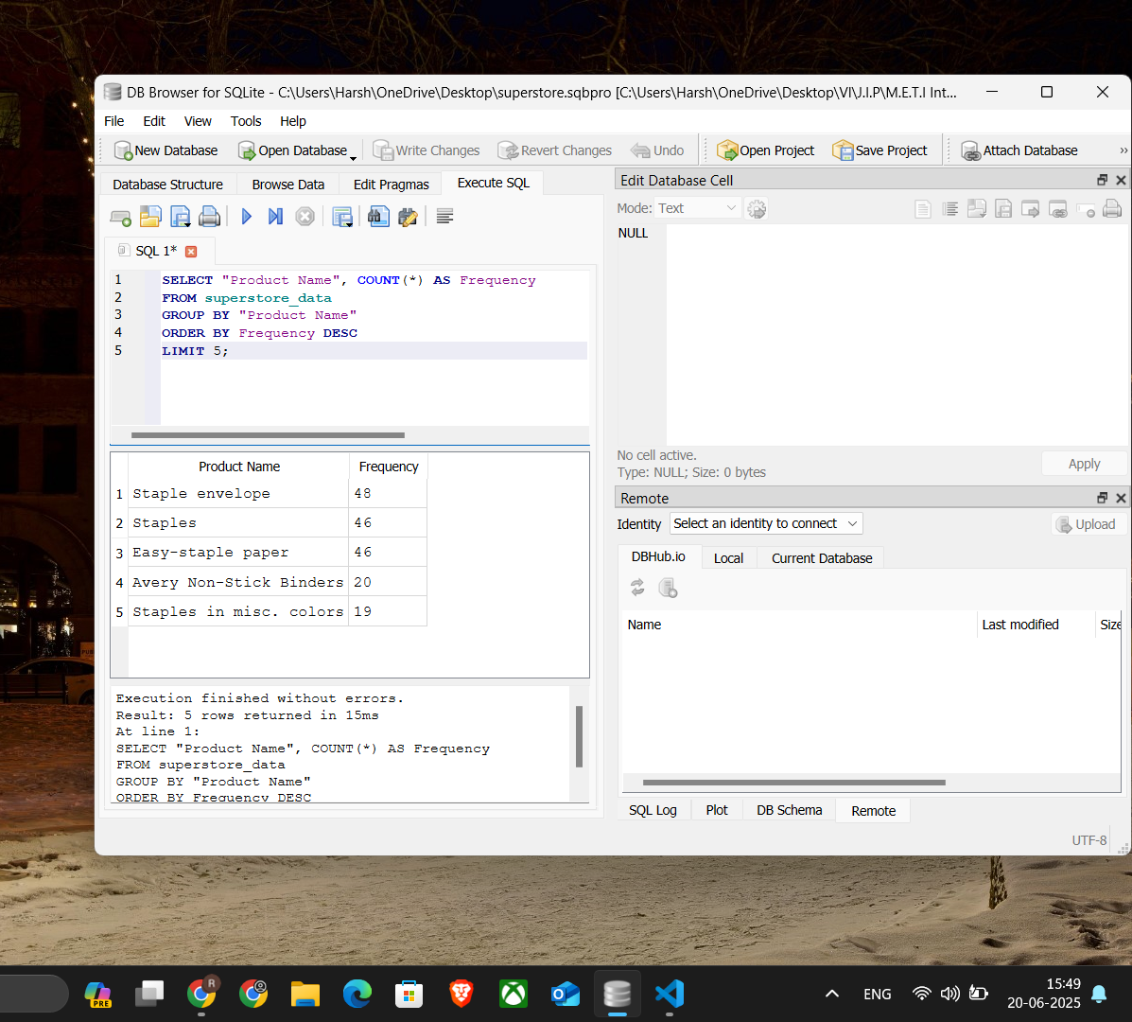
8
8) SELECT "Product Name", COUNT(*) AS Frequency
FROM superstore_data
GROUP BY "Product Name"
ORDER BY Frequency DESC
LIMIT 5;

